Slide 1


Data Science Tools: Intro to R
3-March-2020
Sepi Chakaveh & Assel Altayeva
Overview Data Science

Slide 2
Statistical applications – beyond summaries and basic graphs towards data exploration and modelling
SPSS
SAS
jamovi
Data Oriented Programming languages –towards analyzing data to address the questions that matter to you
Python
Julia
R

Slide 3
Python or R
R
R is one of the oldest programming language developed by academics and statisticians. R comes into existence in the year 1995. Now R is providing the richest ecosystem for data analysis.
Python
On the other hand Python can do the same tasks as R programming language does. The major features of python are data wrangling, engineering, web scraping and so on. Python is also having the tools that help in implementing the machine learning at large scale.

Slide 4
Python or R
R or Python Usage
Python has developed by Guido van Rossum in 1991. Python is the most popular programming language in the world. It has most powerful libraries for math, statistic, artificial intelligence and machine learning. But still python is not useful for econometrics and communication, and also for business analytics.

Slide 5
Python or R
R is more functional, Python is more object-oriented
R is more functional, it provides variety of functions to the data scientist i.e Im, predict and so on. Most of the work done by functions in R. On the other hand Python use classes to perform any task within the python.
R has more data analysis built-in, Python relies on packages.
R provides the build in data analysis for summary statistics, it is supported by summary built-in functions in R. But on the other hand we have to import the statsmodel packages in Python to use this function. In addition there is also a built in constructor in R i.e is dataframe. On the other hand we have to import it in Python.

Slide 6
Python or R
R has more statistical support in general.
R was created as a statistical language, and it shows . statsmodels in Python and other packages provide decent coverage for statistical methods, but the R ecosystem is far more large.
It’s usually more straightforward to do non-statistical tasks in Python.
With well-placed libraries like beautifulsoup and request, web scraping in Python is much easier than R. This applies to other tasks that we don’t see closely, such as saving the database, deploying the Web server, or running a complex selfie.

Slide 7
Python or R
There are many parallels between the data analysis workflow in both.
R and Python are the clearest points of inspiration between the two (pandas were inspired by the Dataframe R Dataframe, the rvest package was inspired by the Sundersaute), and the two ecosystems are getting stronger. It may be noted that the syntax and approach for many common tasks in both languages are the same.

Slide 8
Why R?
R is the most preferred programming tool for statisticians, data scientists, data analysts and data architects
R has over 10,000 packages (a lot of available algorithms) from multiple repositories.

Slide 9
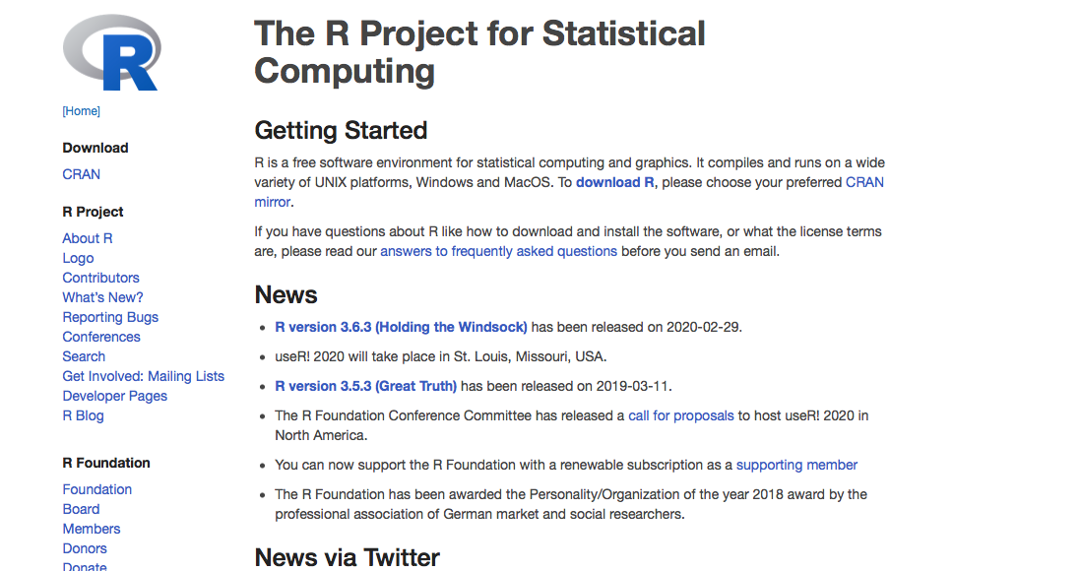
Installing R
Go to -> https://www.r-project.org
Click download R
Environments:
https://notebooks.azure.com
https://www.anaconda.com/distribution/
https://rstudio.cloud/ or https://rstudio.com/products/rstudio/download/#download

Slide 10
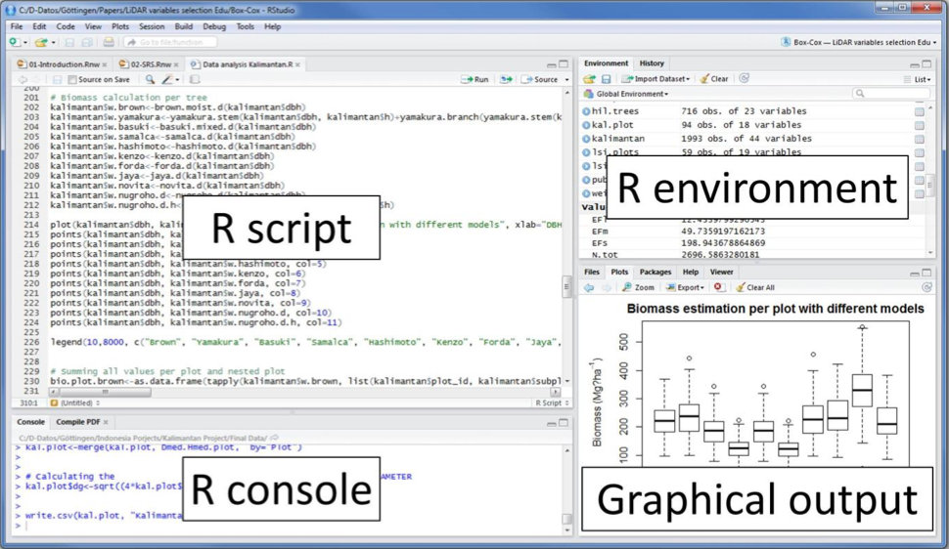
R &R studio IDE

Slide 11
Navigating R
# INSTALL AND LOAD PACKAGES ##############
Load base packages manually
library(datasets) # For example datasets
# LOAD AND PREPARE DATA ##################
?iris
df <- iris
head(df)
# ANALYZE DATA #####################
hist(df$Sepal.Width,
main = "Histogram of Sepal Width",
xlab = "Sepal Width (in cm)")

Slide 12
Navigating R
# CLEAN UP #####################################
# Clear environment
rm(list = ls())
# Clear packages
detach("package:datasets", unload = TRUE) # For base
# Clear plots
dev.off() # But only if there IS a plot
# Clear console
cat("\014") # ctrl+L

Slide 13
Entering Data
# BASIC COMMANDS ###########################################
2+2 # Basic math; press cmd/ctrl enter
1:100 # Prints numbers 1 to 100 across several lines
print("Hello World!") # Prints "Hello World" in console
# ASSIGNING VALUES #########################################
# Individual values
a <- 1 # Use <- and not =
2 -> b # Can go other way, but silly
c <- d <- e <- 3 # Multiple assignments
# Multiple values
x <- c(1, 2, 5, 9) # c = Combine/concatenate
x # Print contents of x in Console

Slide 14
Entering Data
# SEQUENCES ################################################
# Create sequential data
0:10 # 0 through 10
10:0 # 10 through 0
seq(10) # 1 to 10
seq(30, 0, by = -3) # Count down by 3
# MATH ################################################
# Surround command with parentheses to also print
(y <- c(5, 1, 0, 10))
x + y # Adds corresponding elements in x and y
x * 2 # Multiplies each element in x by 2
2^6 # Powers/exponents
sqrt(64) # Squareroot
log(100) # Natural log: base e (2.71828...), base 10 would be log10

Slide 15
Data types
# Numeric (Real, Integers, Complex)##########
n1 <- 15 # Double precision by default
n1
typeof(n1)
#Character################
c1 <- "c"
typeof(c1)
c2 <- "a string of text"
typeof(c2)
#Logical (True / False)##############
l1 <- TRUE
l1
typeof(l1)

Slide 16
Data Structures
Vector: a vector contains object of same class
List: a special type of vector which contain elements of different data types
Matrix: A matrix is represented by set of rows and columns.
Data frame: Every column of a data frame acts like a list

Slide 17
Data Structures
## Vector ======
v1 <- c(1, 2, 3, 4, 5) #vector of numbers
v1
is.vector(v1)
## Matrix =======
m1 <- matrix(c(T, T, F, F, T, F), nrow = 2)
m1
m2 <- matrix(c("a", "b", "c", "d"),
nrow = 2,
byrow = T)
m2

Slide 18
Data Structures
## Array =====================
# Give data, then dimensions (rows, columns, tables)
a1 <- array(c( 1:24), c(4, 3, 2))
a1
## List ======================
o1 <- c(1, 2, 3)
o2 <- c("a", "b", "c", "d")
o3 <- c(T, F, T, T, F)
list1 <- list(o1, o2, o3)
list1
list2 <- list(o1, o2, o3, list1) # Lists within lists!
list2

Slide 19
Data Structures
## Data Frame ==============================================
# Can combine vectors of the same length
vNumeric <- c(1, 2, 3)
vCharacter <- c("a", "b", "c")
vLogical <- c(T, F, T)
df1 <- cbind(vNumeric, vCharacter, vLogical)
df1 # Coerces all values to most basic data type
df2 <- as.data.frame(cbind(vNumeric, vCharacter, vLogical))
df2 # Makes a data frame with three different data types

Slide 20
Coercing types
## Automatic Coercion ======================================
# Goes to "least restrictive" data type
(coerce1 <- c(1, "b", TRUE))
typeof(coerce1)
## Coerce Numeric to Integer ===============================
(coerce2 <- 5)
typeof(coerce2)
(coerce3 <- as.integer(5))
typeof(coerce3)

Slide 21
Coercing types
## Coerce Character to Numeric =============================
(coerce4 <- c("1", "2", "3"))
typeof(coerce4)
(coerce5 <- as.numeric(c("1", "2", "3")))
typeof(coerce5)
## Coerce Matrix to Data Frame =============================
(coerce6 <- matrix(1:9, nrow= 3))
is.matrix(coerce6)
(coerce7 <- as.data.frame(matrix(1:9, nrow= 3)))
is.data.frame(coerce7)

Slide 22
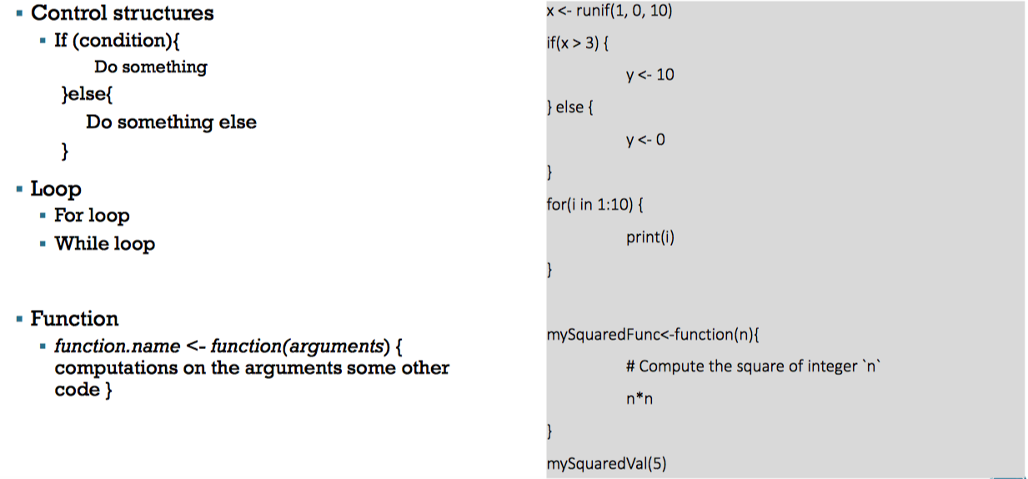
R essentials

Slide 23
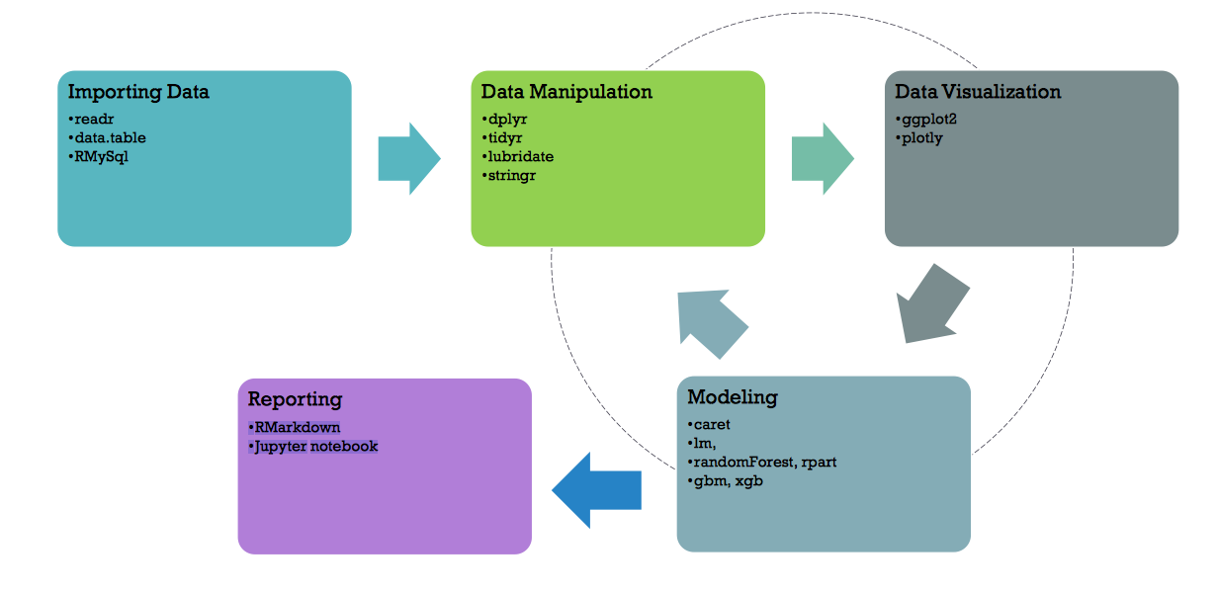
Useful R packages
Install packages: install.packages (“readr”, ”ggplot”, ”dplyr”, ”caret”)
Load packages: library(package_name)

Slide 24
Installing and loading packages
# Install pacman ("package manager") if needed
if (!require("pacman")) install.packages("pacman")
# Load contributed packages with pacman
pacman::p_load(pacman, party, psych, rio, tidyverse)
# pacman: for loading/unloading packages
# party: for decision trees
# psych: for many statistical procedures
# rio: for importing data
# tidyverse: for so many reasons
# Load base packages manually
library(datasets) # For example datasets

Slide 25
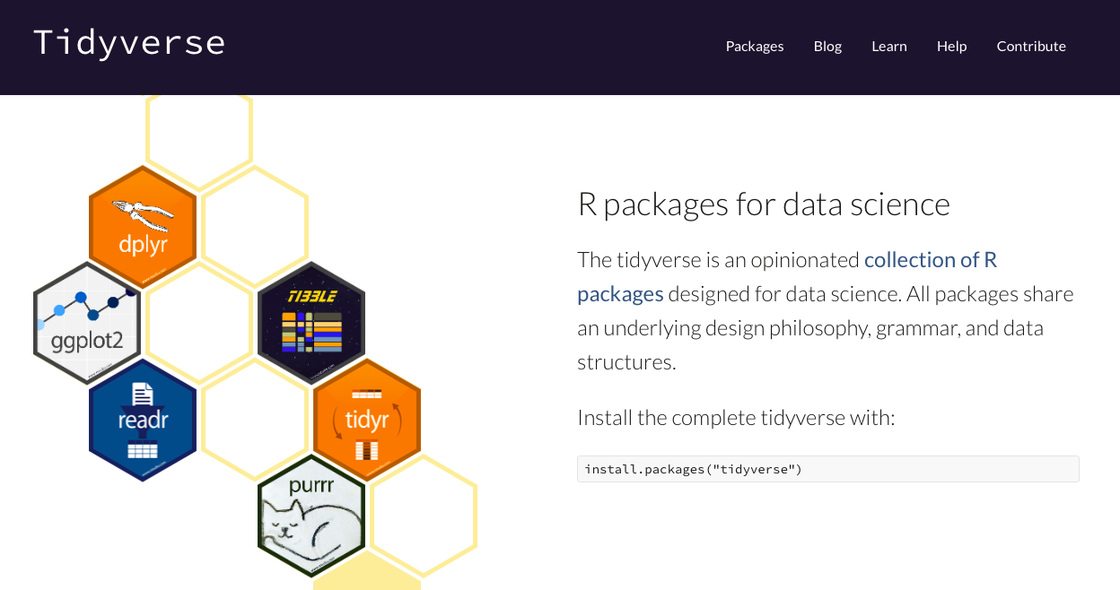
Tidyverse
https://www.tidyverse.org

Slide 26
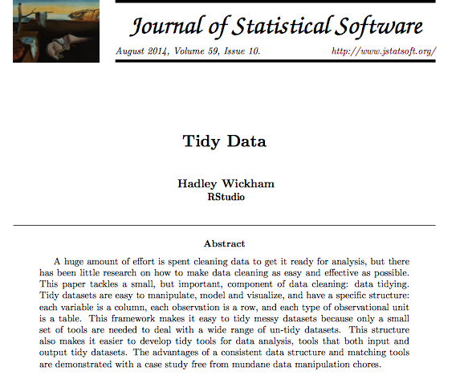
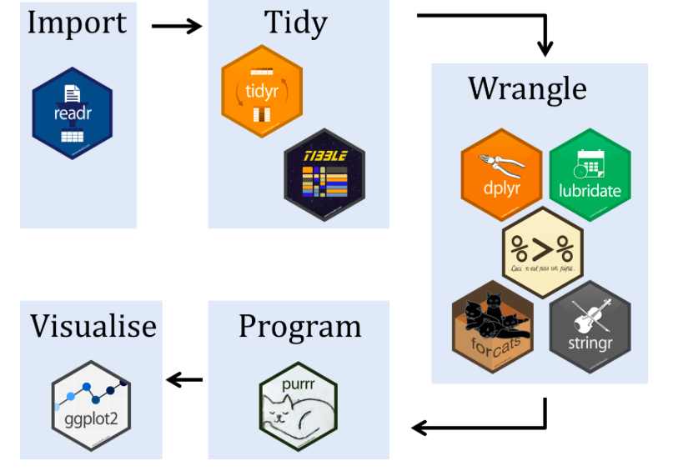
Tidyverse
A collection of packages by Hadley Wickham for::
These packages are all designed to work nicely together
More readable by people than most R code

Slide 27
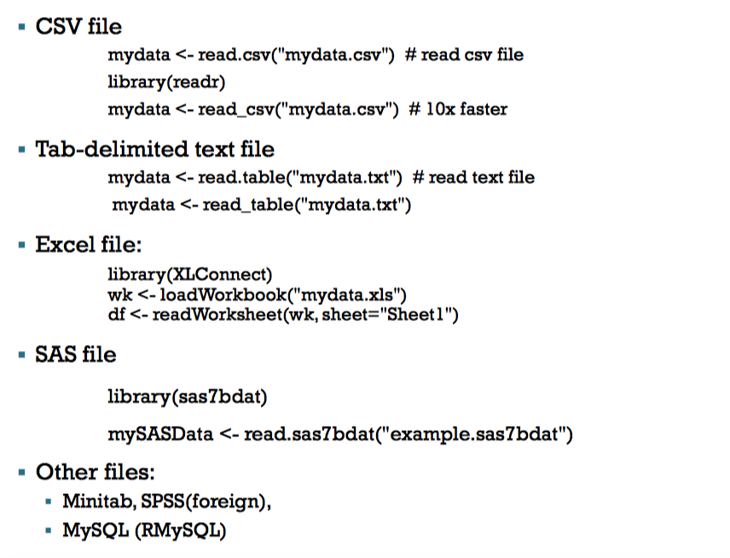
Importing Data

Slide 28
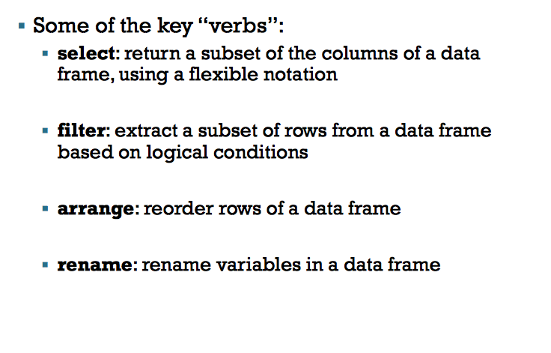
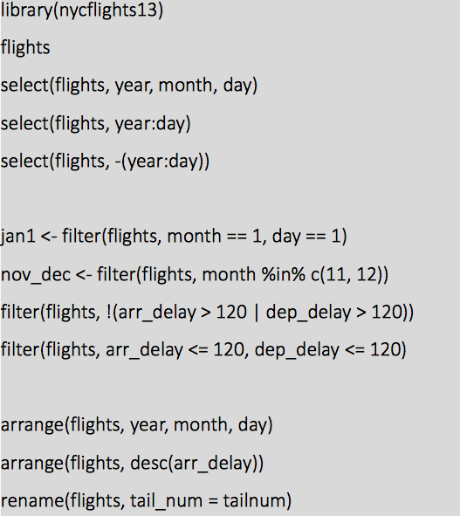
Data manipulation with ’DPLYR’

Slide 29
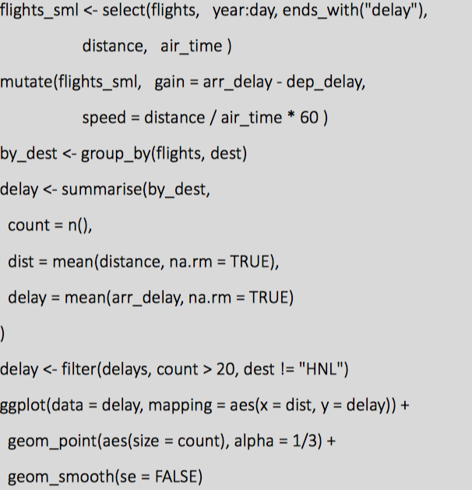
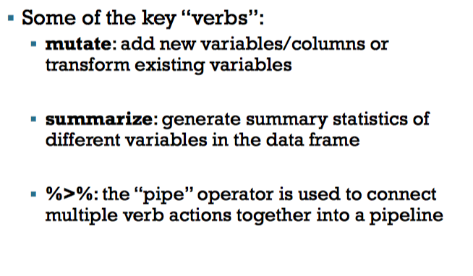
Data manipulation with ’DPLYR’

Slide 30
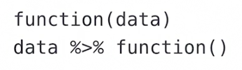
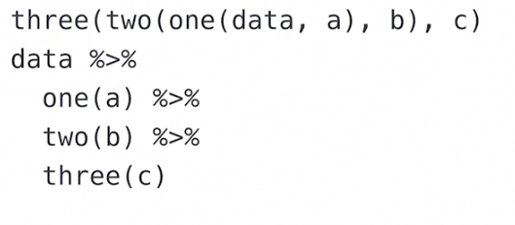
Piping Commands with %>%
The pipe operator is key to why the tidyverse packages are so usable and readable
It passes the thing on its left as the first argument to a function on its right
x %>% f() is equivalent to f(x)
This is amazing for chaining together the various steps some data goes through without needing to create intermediary objects

Slide 31
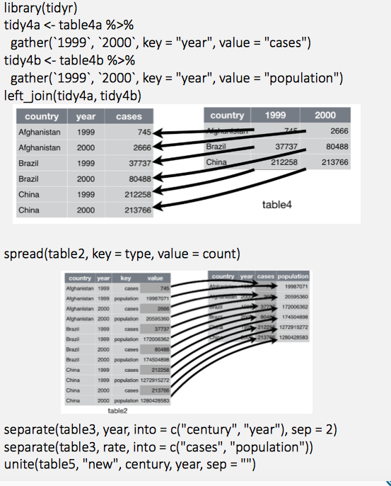
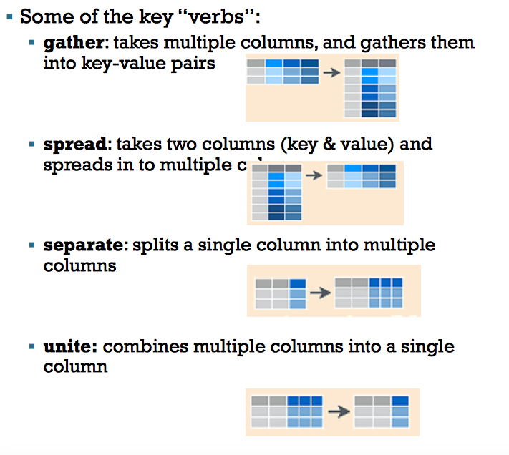
Data Manipulation with ’TIDYR’

Slide 32
Data Visualization with ‘GGPLOT2’
Philosophy
«ggplot2 is designed to work in a layered fashion, starting with a layer showing the raw data then adding layers of annotation and statistical summaries. [..]»
«ggplot2 is a plotting system for R, based on the grammar of graphics, which tries to take the good parts of base and latticegraphics and none of the bad parts.»
«It takes care of many of the fiddly details that make plotting a hassle (like drawing legends) as well as providing a powerful model of graphics that makes it easy to produce complex multi-layered graphics.»
How to use ggplot
In contrast to the regular plot() function, ggplot is based on the grid- package for drawing all plots (as is lattice)
Therefore, ggplot is not «really» compatible with the default plot-functions
Plots are drawn in layers that are stacked on top of each other
To create a plot we either use the qplot() or ggplot() function

Slide 33
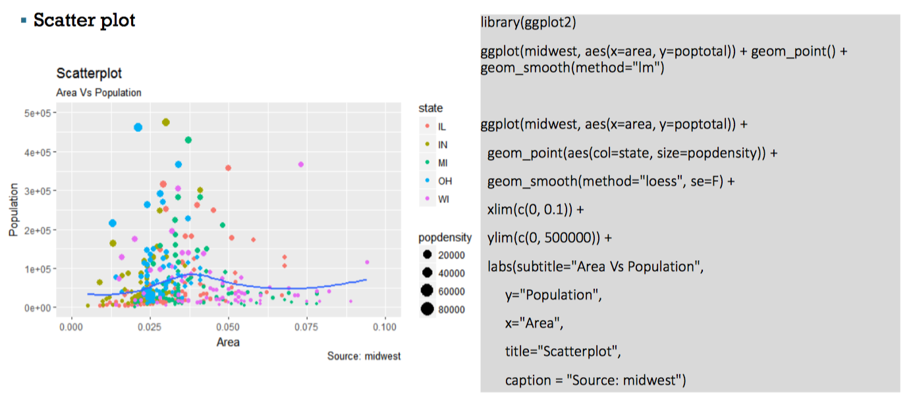
Data Visualization with ‘GGPLOT2’

Slide 34
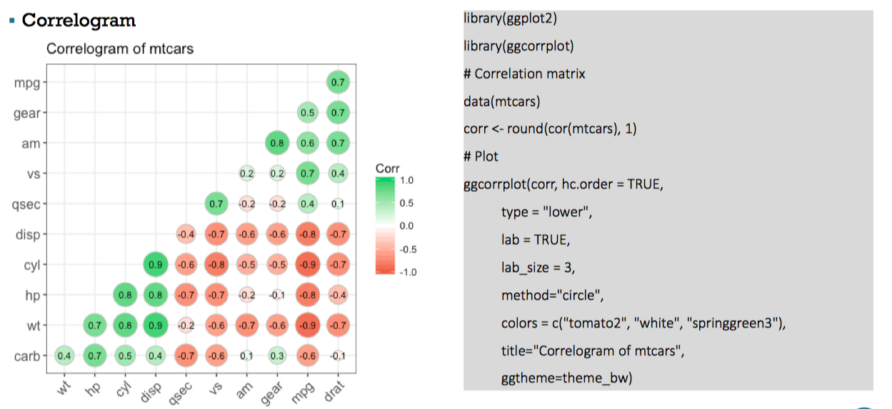
Data Visualization with ‘GGPLOT2’

Slide 35
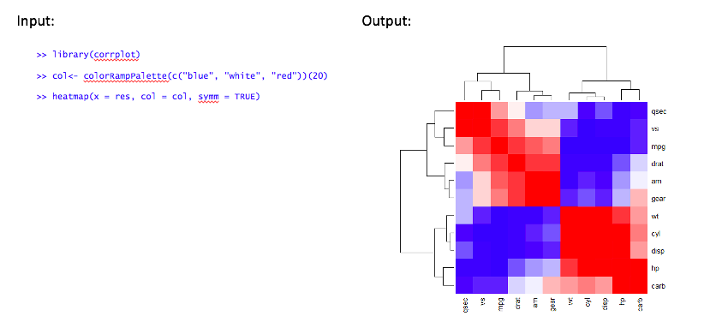
Does it correlate?
>> install.packages("corrplot")
>> library(corrplot)
>> #cor(x, method = "pearson", use = "complete.obs")
>> cor(mtcars)
>> library(corrplot)
>> col<- colorRampPalette(c("blue", "white", "red"))(20)
>> heatmap(x = res, col = col, symm = TRUE)

Slide 36
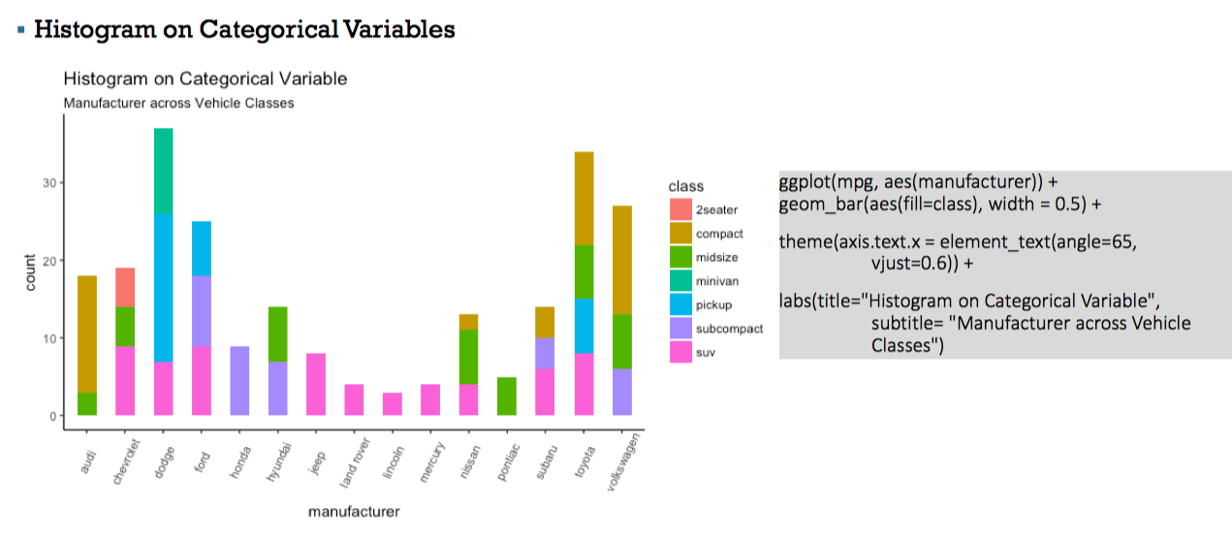
Data Visualization with ‘GGPLOT2’

Slide 37
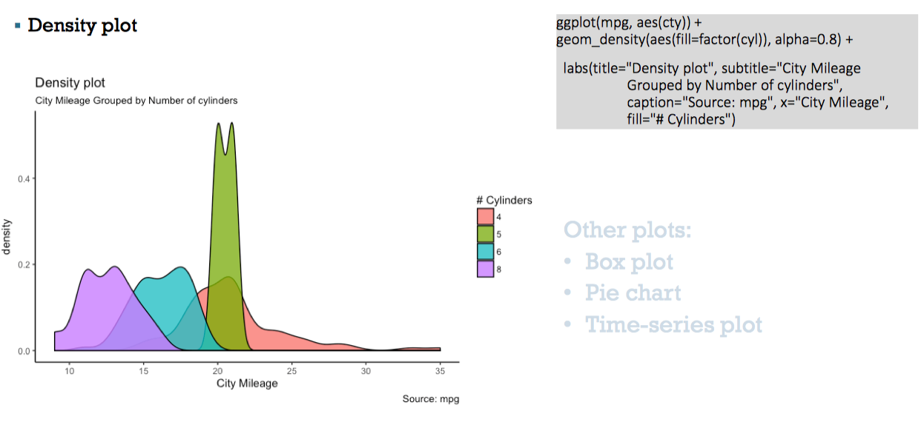
Data Visualization with ‘GGPLOT2’

Slide 38
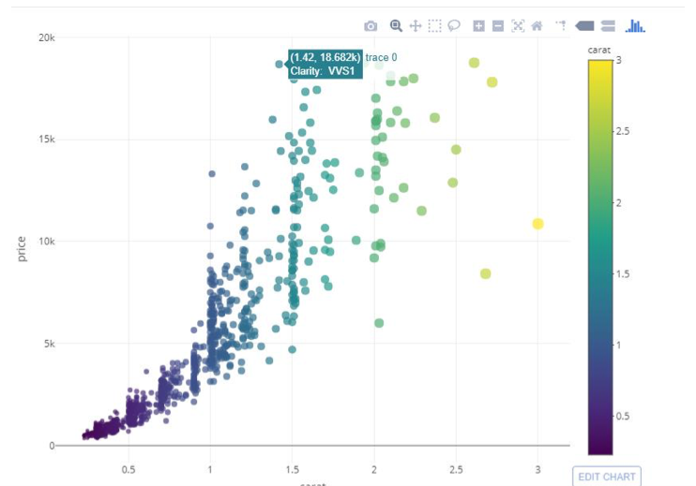
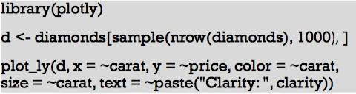
Interactive visualization with ‘PLOTLY’

